Slide 1
Microservices and DevOps
DevOps and Container Technology
Learning SkyCave
Henrik Bærbak Christensen

Slide 2
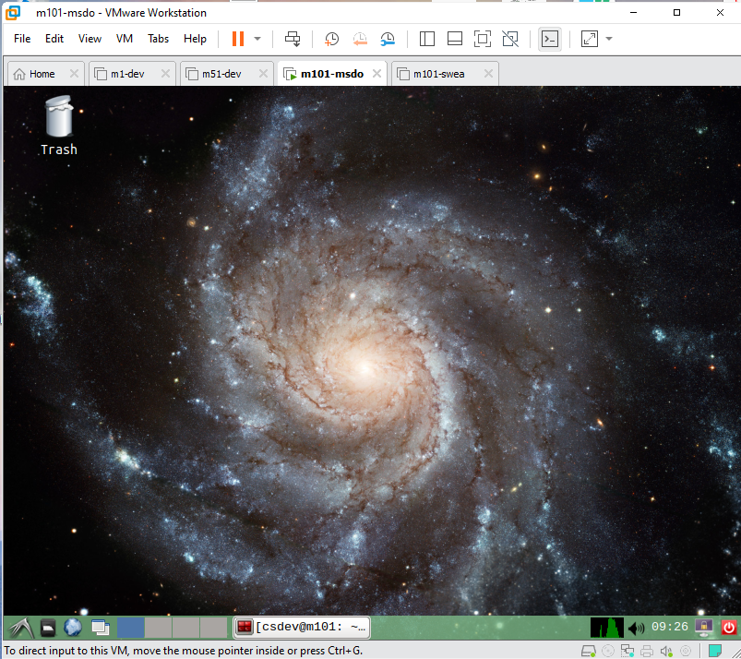
Exercise 1
Get the Mxx VM up and running
User: csdev, pwd: csau
Alternative:
Install
Java SDK 11+
Gradle 6.8+
Docker
IntelliJ

Slide 3
Exercise 2
Start on the Mandatory Iteration 0 exercises…

